Slide 1

emlix GmbH – We realize industrial-grade Linux
An Overview of my Company
By Frank Michael Becker

Slide 2
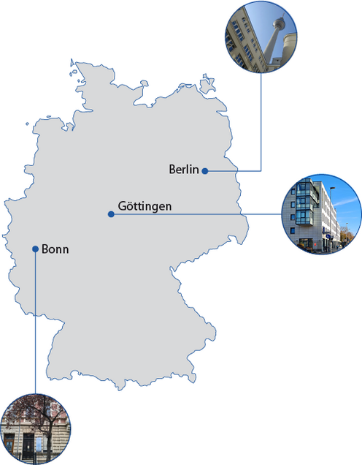
About emlix GmbH
An Overview of my Company:
Headquarter in Göttingen
~ 50 Employees (GÖ, B, BN)
Embedded Linux Systems
International customers

Slide 3
END
To Continue…
Or not…
Who knows?
Well I don‘t…
Thanks for listening!

